Slide 1
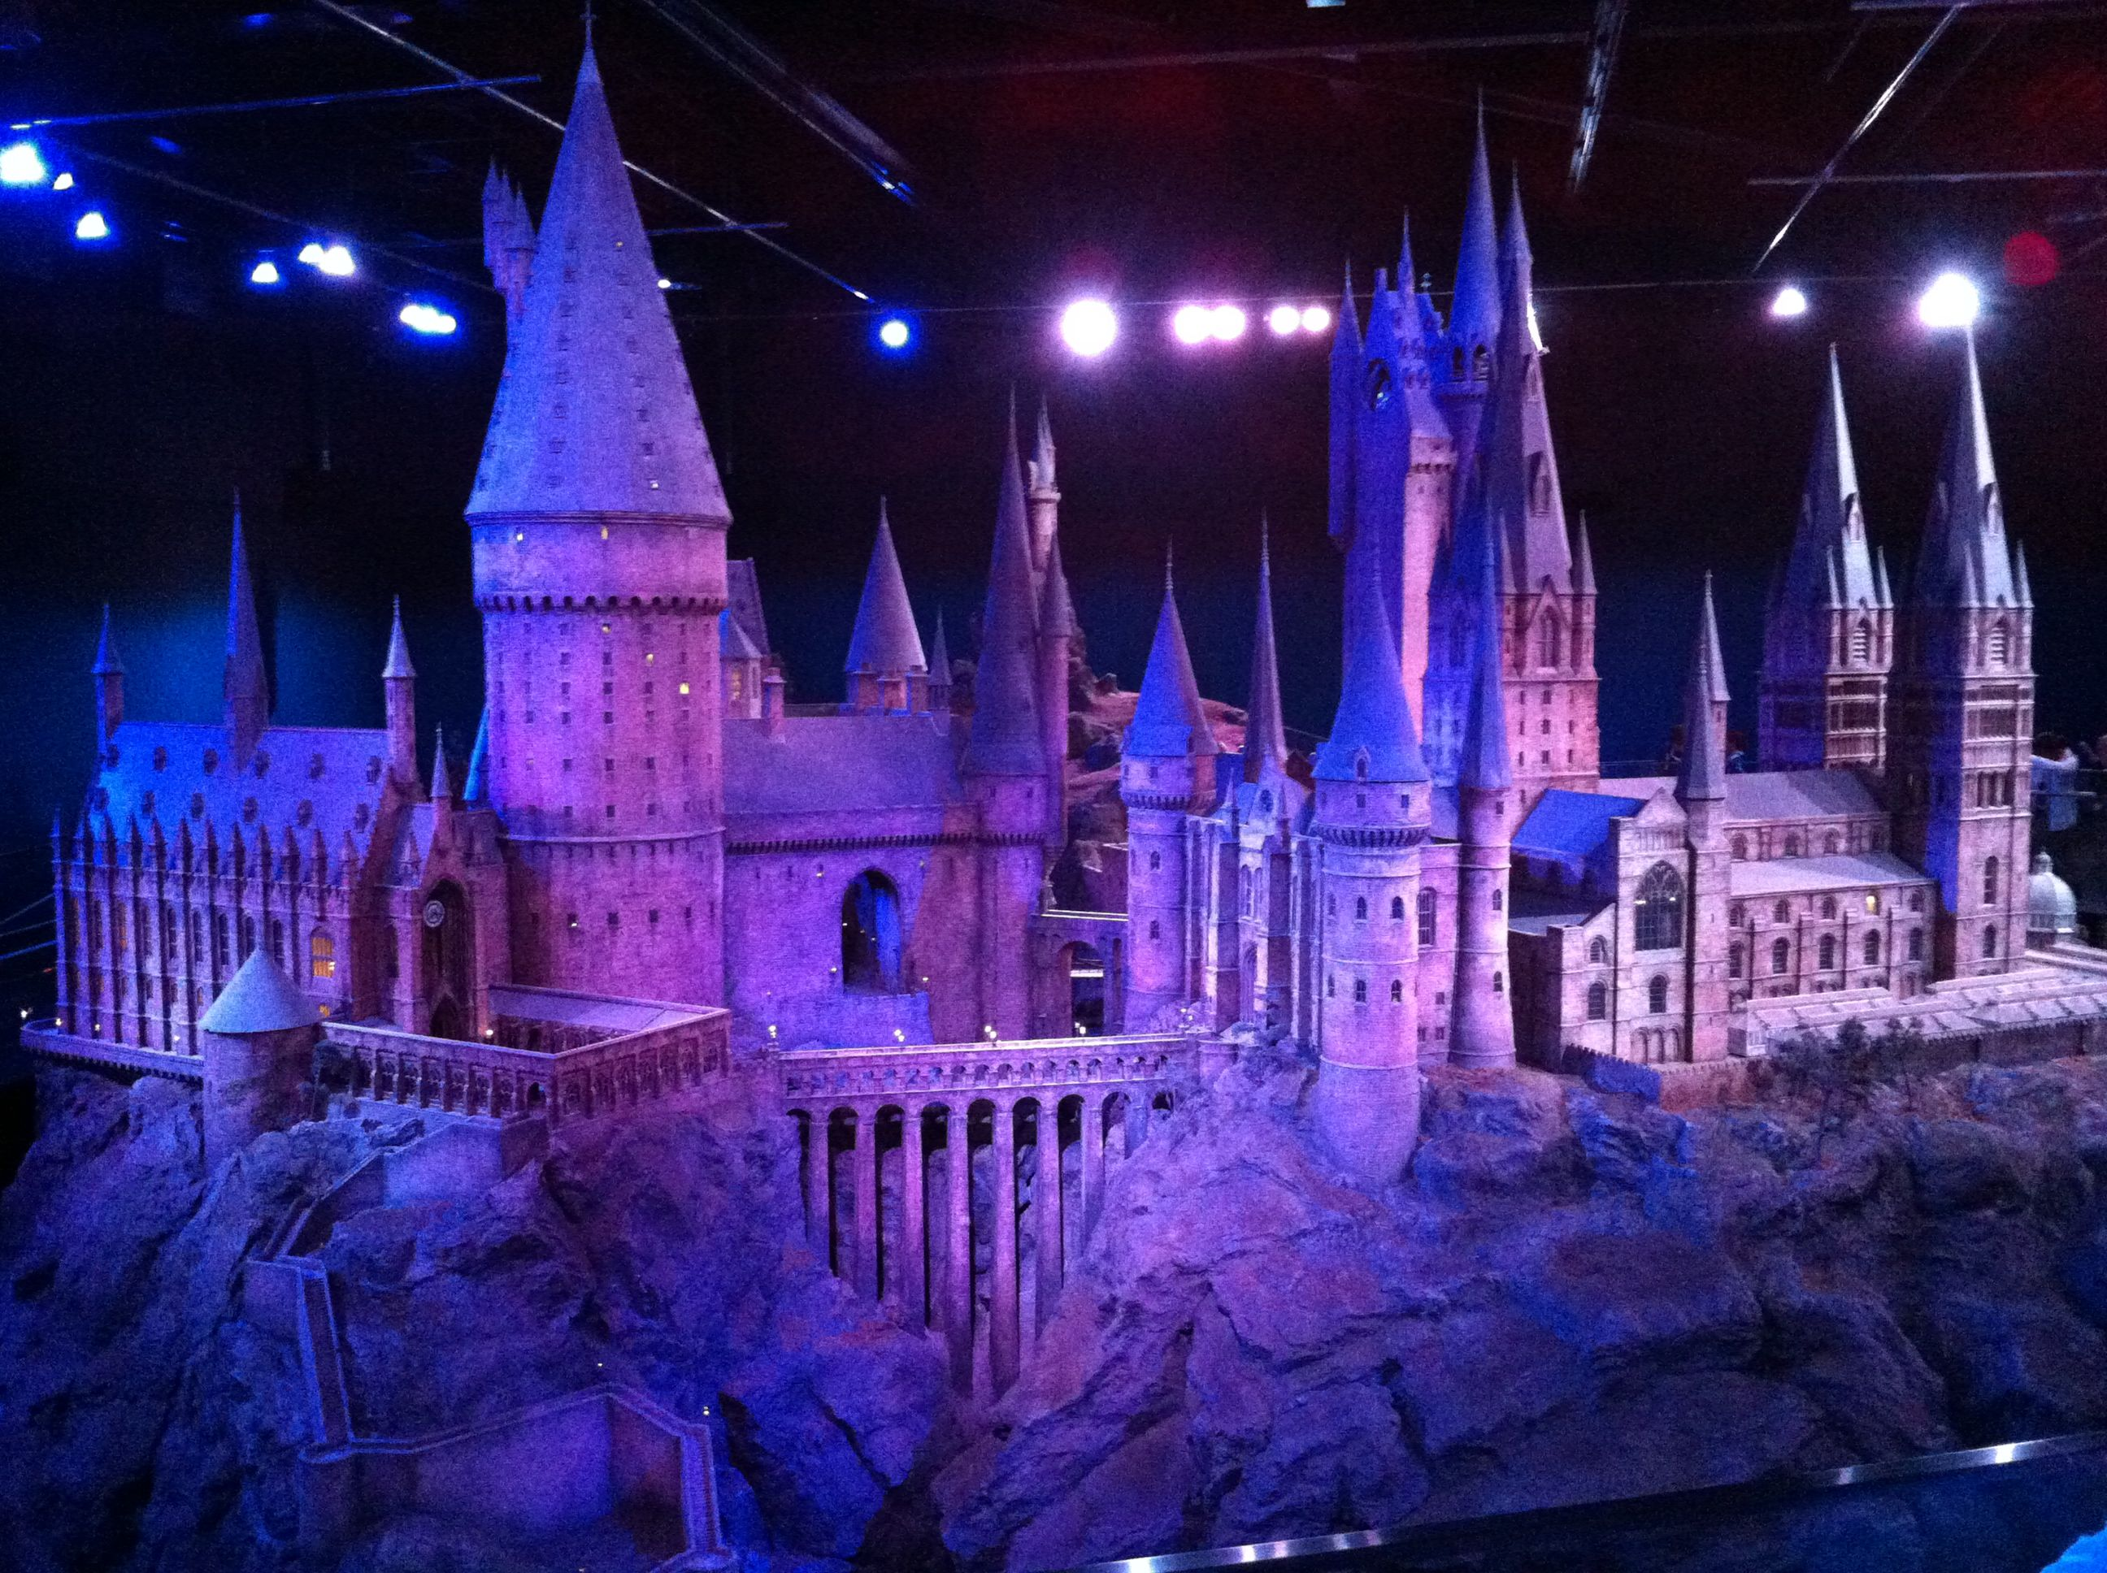

http://www.youtube.com/watch?v=hQwtcnYK9JM

Slide 2

Must:
Be able to describe how 6 figure grid references are used to pinpoint locations on maps.
Should:
Be able to interpret contours lines height and relief
Could:
Be able to create an accurate cross section from contours on a map

Slide 3
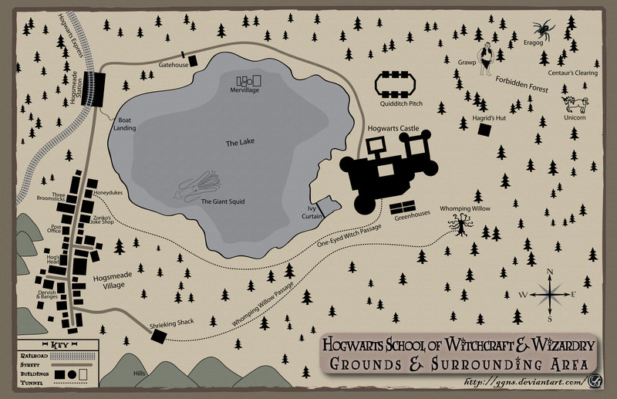
50
49
48
47
46
45
11
12
13
14
15
16
17
18
19

Slide 4
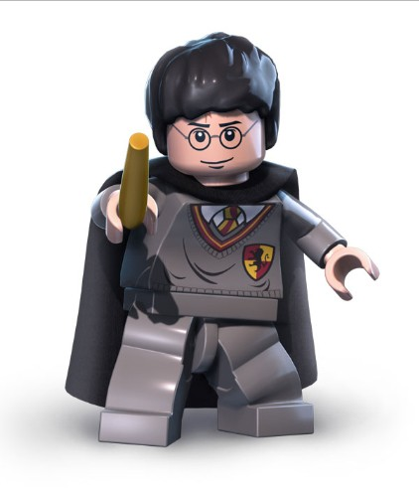
Write the 6 figure grid references for the following places on the Hogwarts map
Hagrid’s hut
The Gatehouse
Whomping Willow
Hogsmeade Station
Eragog
The Shrieking Shack
Honeydukes sweetshop
Mervillage
The Quidditch pitch
A unicorn
11. The place where you could enjoy a butter beer!
Extension: find another location and write down its 6 figure grid reference the test your partner.

Slide 5
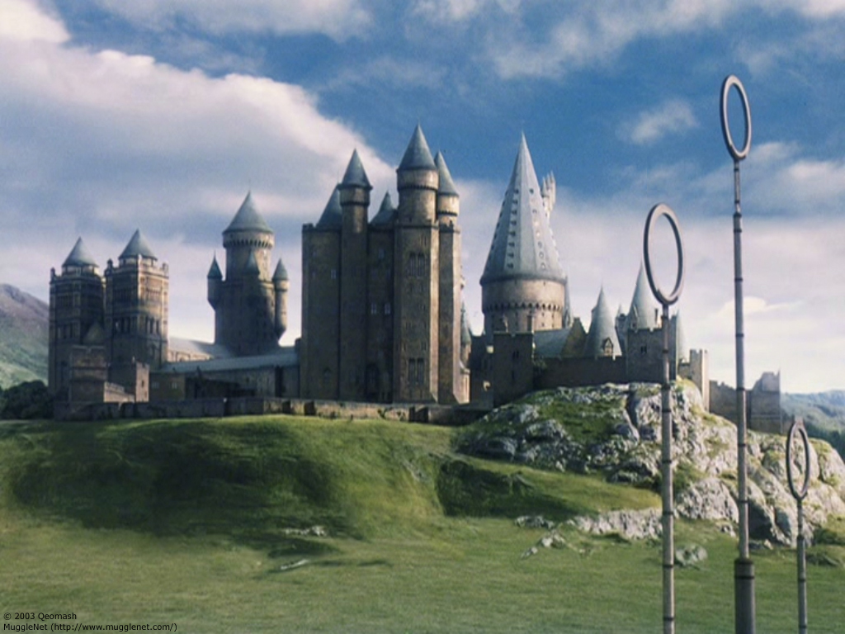
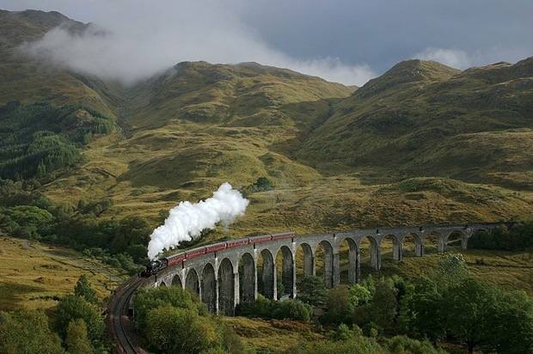
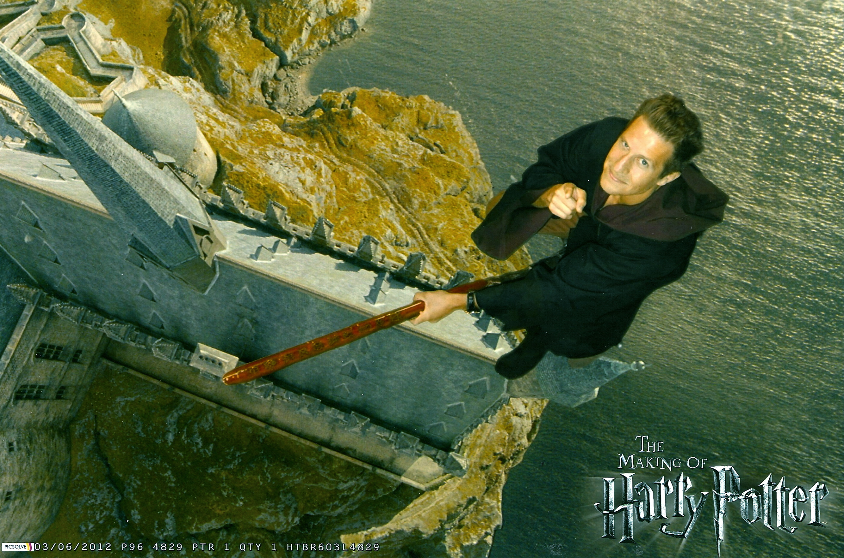
1. What do you notice about the relief of the land around Hogwarts?
2. How do geographers show relief on a map?
http://www.youtube.com/watch?v=bPXJsQjUTm0&feature=related

Slide 6
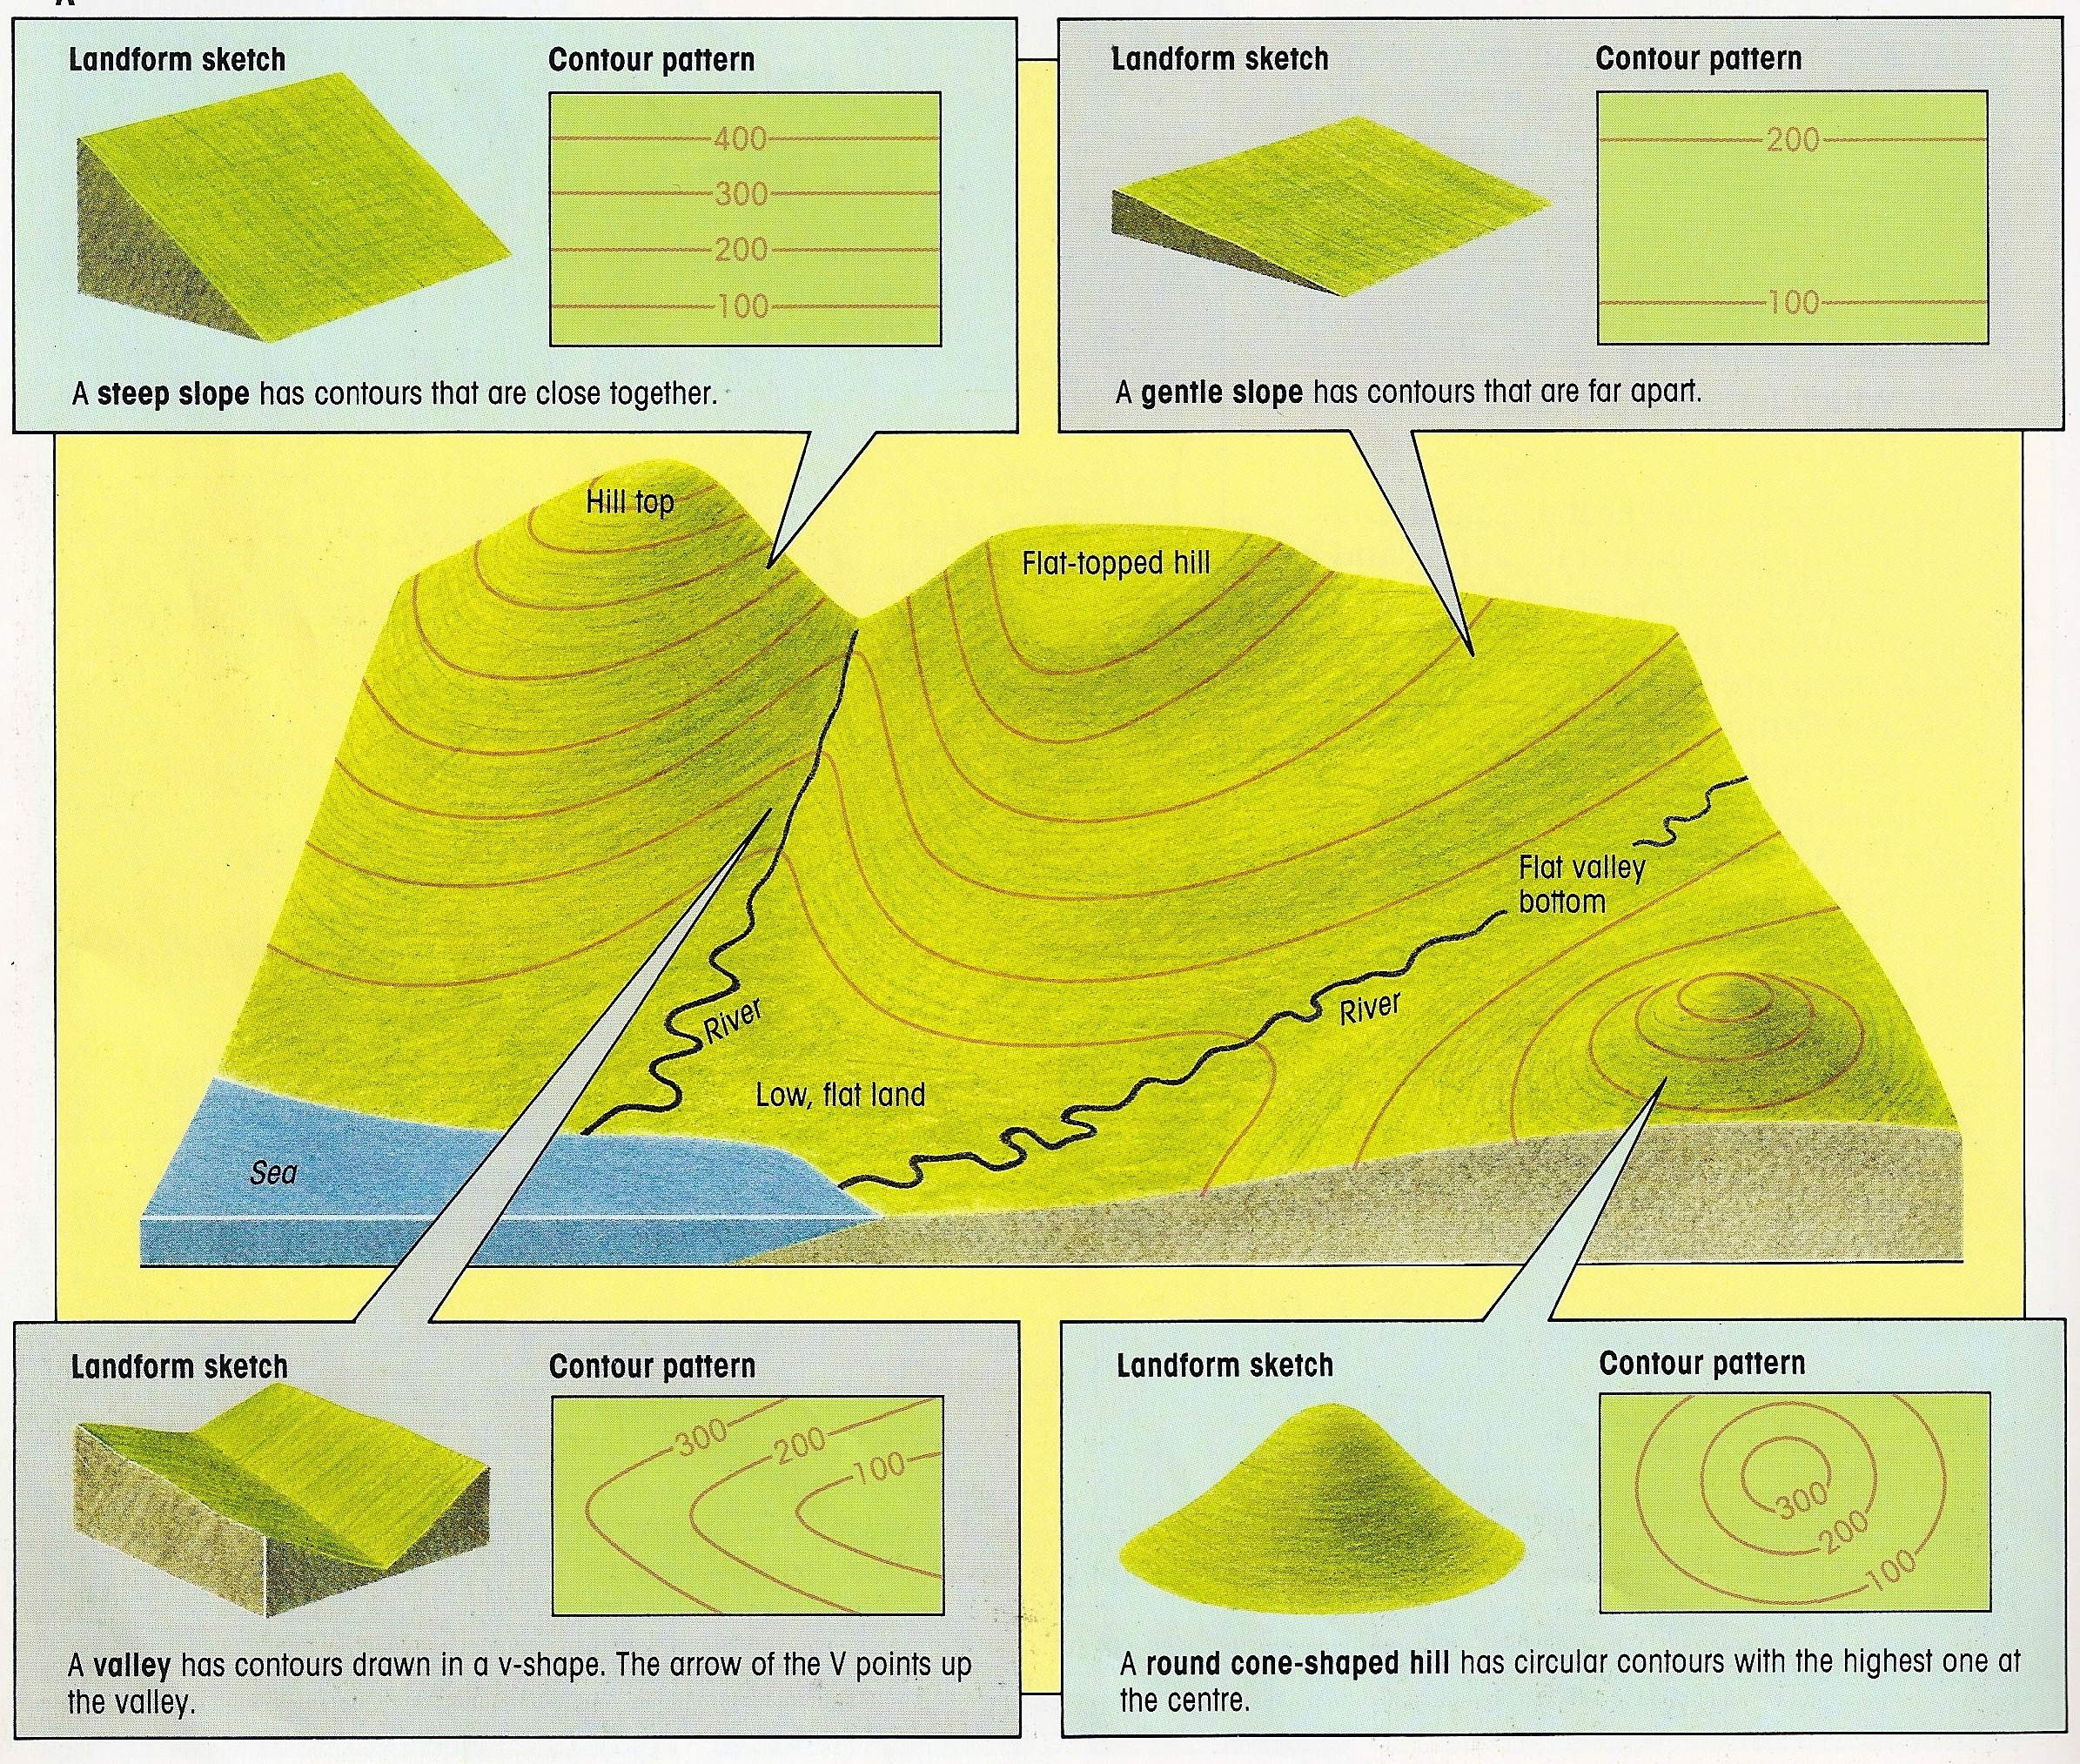
Contour Lines – Lines on a map that join places of the same height
They show the height and relief (shape) of land.
On most OS maps the lines are drawn every 10m.
Several contours together make up a pattern which show the steepness and shape of the land.
The contours have been drawn on the main sketch for you.
Remember the closer the contour lines, the steeper the slope

Slide 7
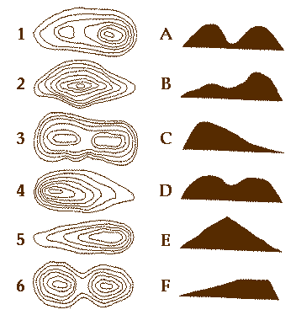
1. Match the contours with the corresponding landscape.
Extension: Try to draw your own landscape profile and the contours that represent it.

Slide 8
20m
A
30m
10m
10m
20m
30m
40m
30m
20m
40m
10m
30m
20m
B
10m
Write down the elevation (height) of: The Shrieking Shack, Quidditch stadium, Hogsmeade Station, Whomping Willow, Gate House, Post office, Unicorn, Gawp, Hagrid’s Hut.
Rank them into order of elevation; highest to lowest.
20m
30m
40m
Extension: What is the feature in the north-east of the map shown by the ‘V’ like contour lines.
50m

Slide 9

Draw a profile of the line A-B on the Hogwarts map
50m
50m
40m
40m
30m
30m
20m
20m
10m
10m
0m
0m
Draw on the Hogwarts castle and the Quidditch stadium.

Slide 10

Complete the OS map contour activity sheet
In pairs…
Use an OS map to quiz classmates on the heights of places on that map.
Give them the 6 figure grid reference to find the place you are referring to.

Slide 11
THE HOT SEAT!
I need a brave volunteer!
Its about to get hot like a warm butter-beer in here!
While our volunteer steps outside the room…
As a class, come up with some key terms from today’s lesson. DO NOT reveal them to our volunteer.
When our volunteer returns, we shall try to describe those words him/her.

Slide 12

On a post-it note
Write…
1 thing that you already knew
1 thing that you have learnt today
1 thing that you would like to find out

Slide 13
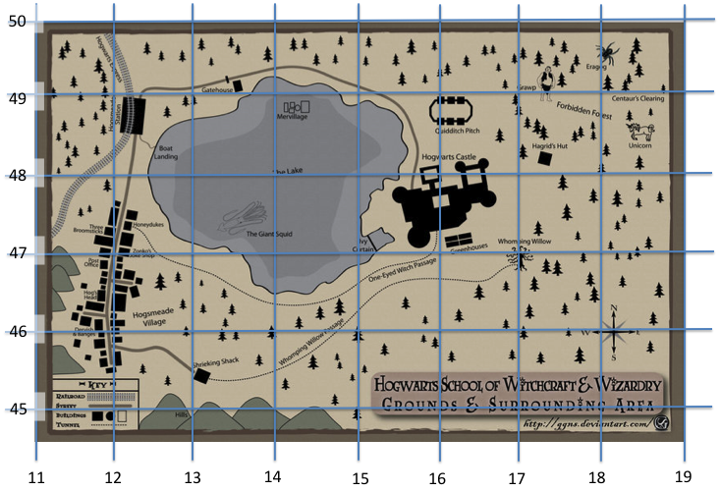
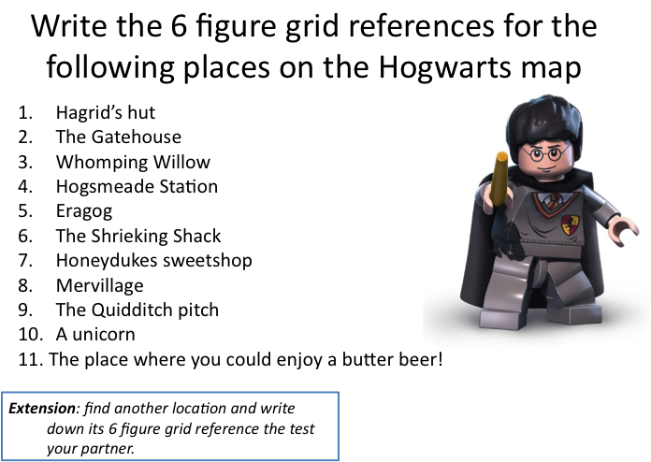

Slide 14
